Slide 1

RGB-D image segmentation
MSc Big Data Science
Project Report 2018
Lyapina Ekaterina
School of Electronic Engineering and Computer Science

Slide 2

Objectives
Developing a framework for working with NYU and SUN RGB-D dataset in a popular annotation format
Implementation of the Mask RCNN model for NYU and SUN RGB-D dataset
Fine-tuning a model
Evaluation the quality of RGB image segmentation model working with RGB-D dataset
Providing integration with Kinect v2 for a demonstration
.

Slide 3
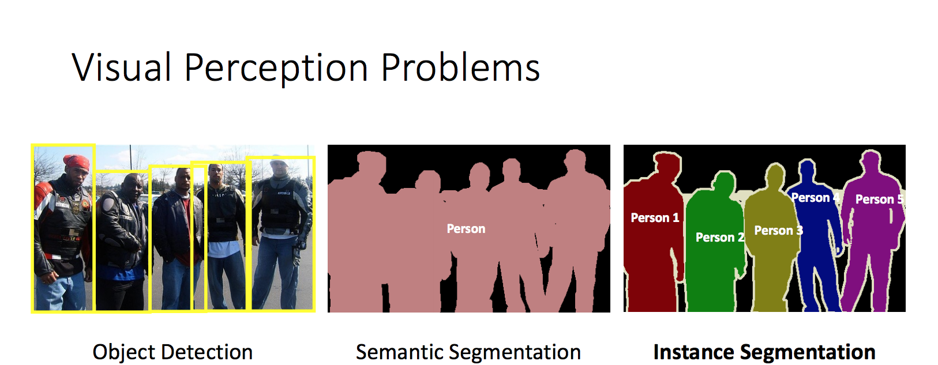

Slide 4
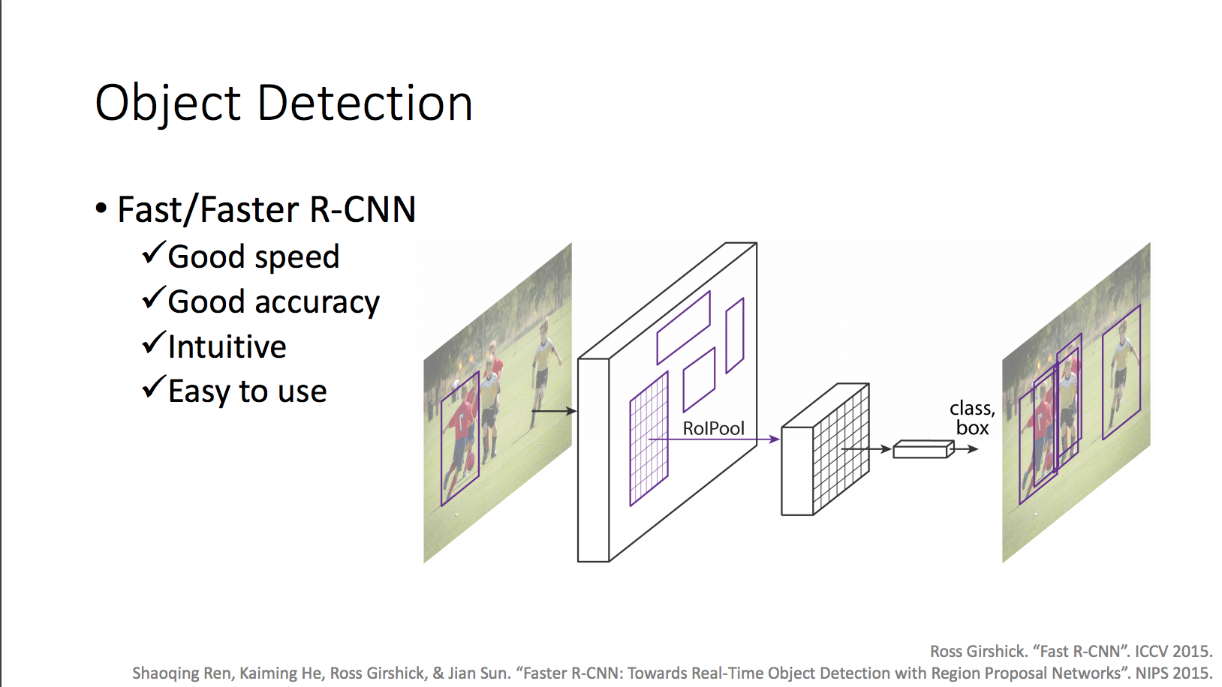
State-of-the-art in object detection
R-CNN, followed by Fast R-CNN and Faster R-CNN: assign a reasonable number of candidate object regions and evaluate convolutional networks independently on each region of interest (RoI).

Slide 5
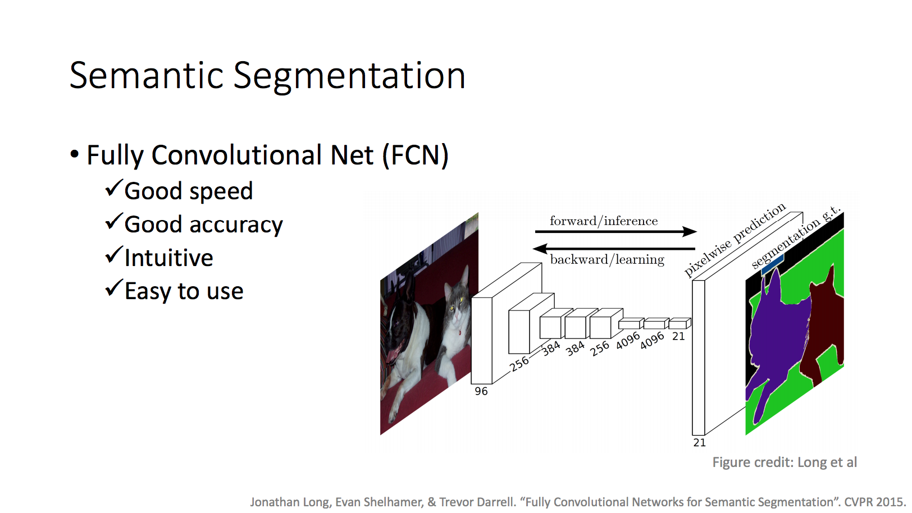

Slide 6
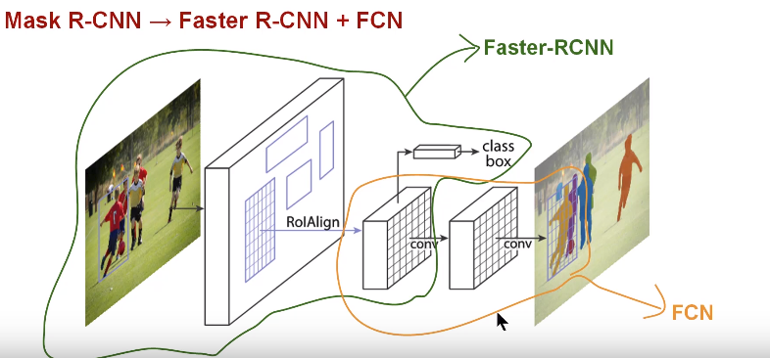
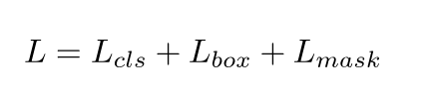
Mask R-CNN

Slide 7
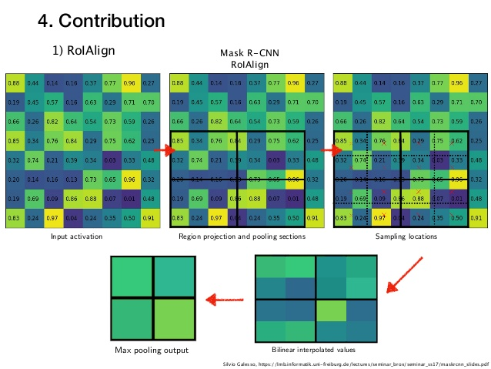
RoIAlign pooling
divide the h x w ROI as H x W sub-windows, then max-pool
reported to have ~3 points improvement in AP

Slide 8
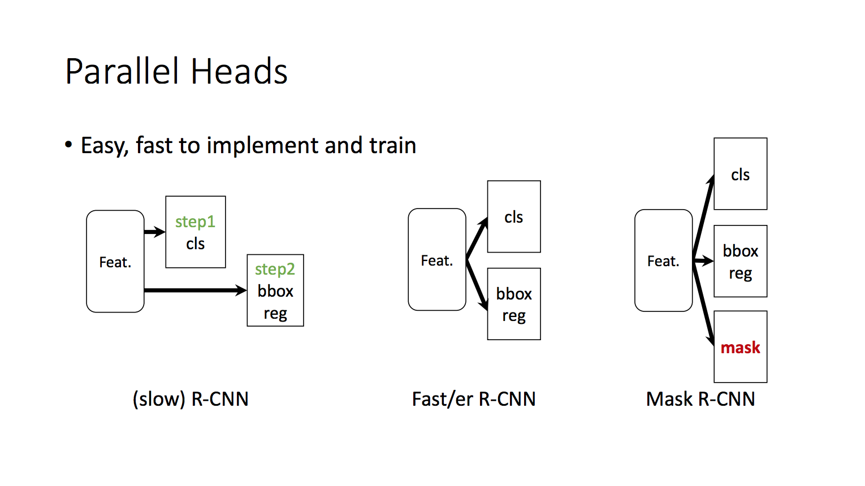
Mask RCNN v1: Faster R-CNN with VGG-16 backbone and FCN
Mask RCNN v2: Faster R-CNN with ResNet-101 and FPN

Slide 9
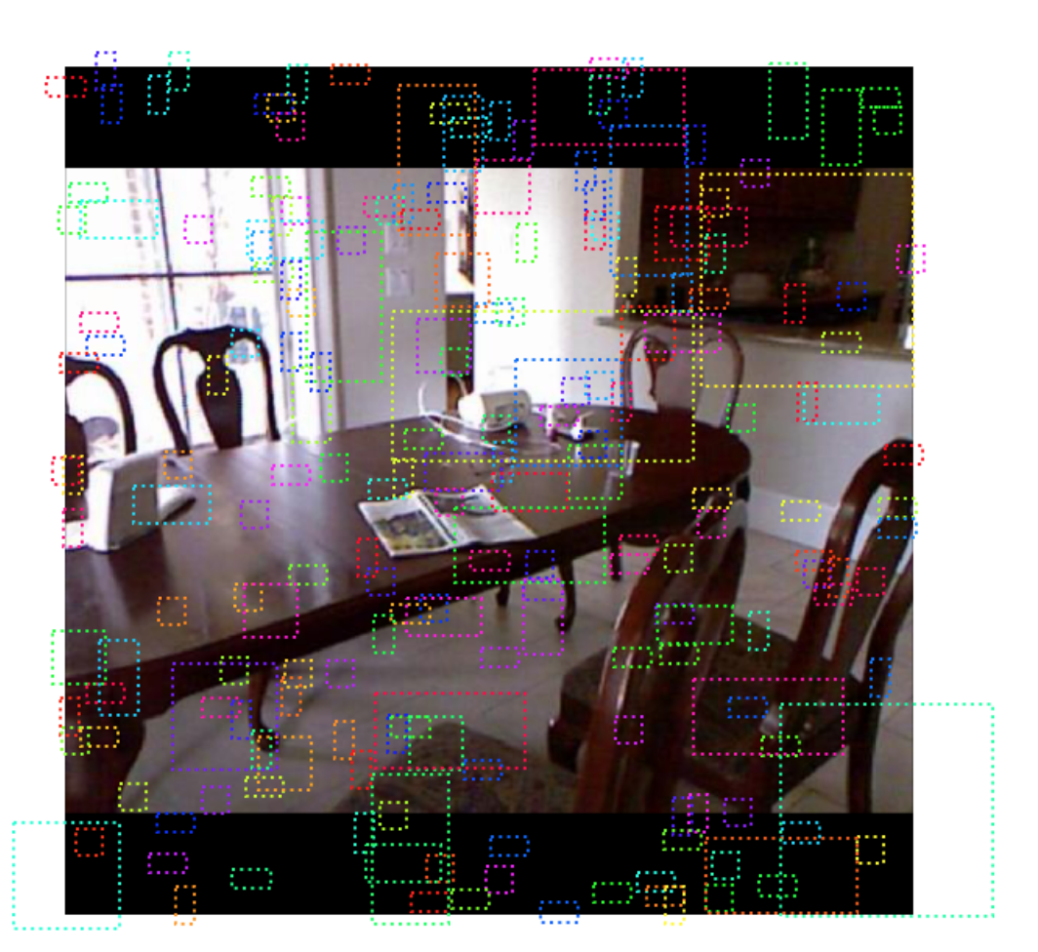
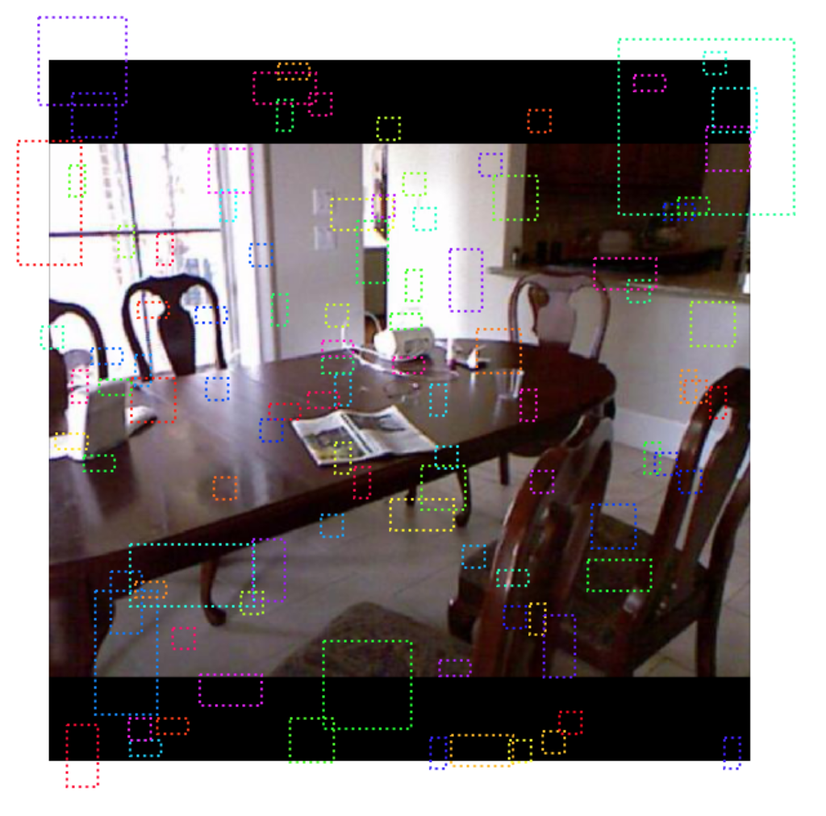
Annotation in Mask RCNN
Negative
Neutral
Faster R-CNN does not make random boundary box proposals. Instead, it predicts offsets that are relative to the top left corner of some reference boxes called anchors.

Slide 10
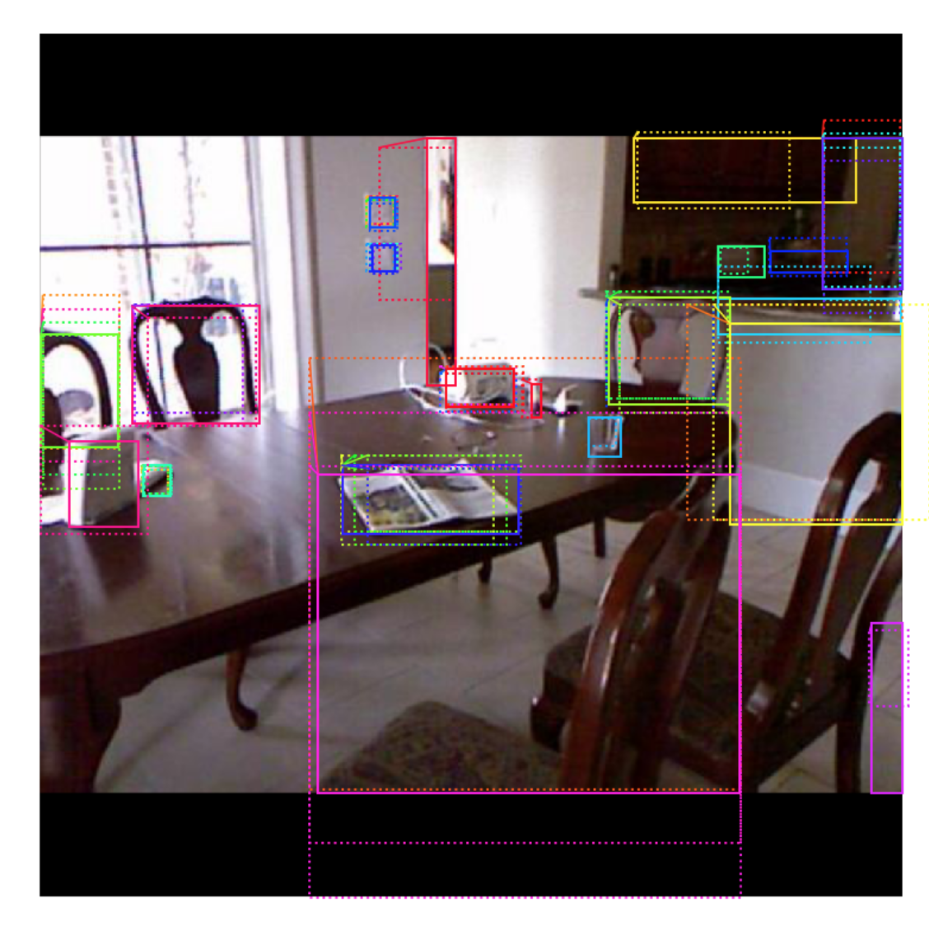
Positive annotation in Mask RCNN

Slide 11
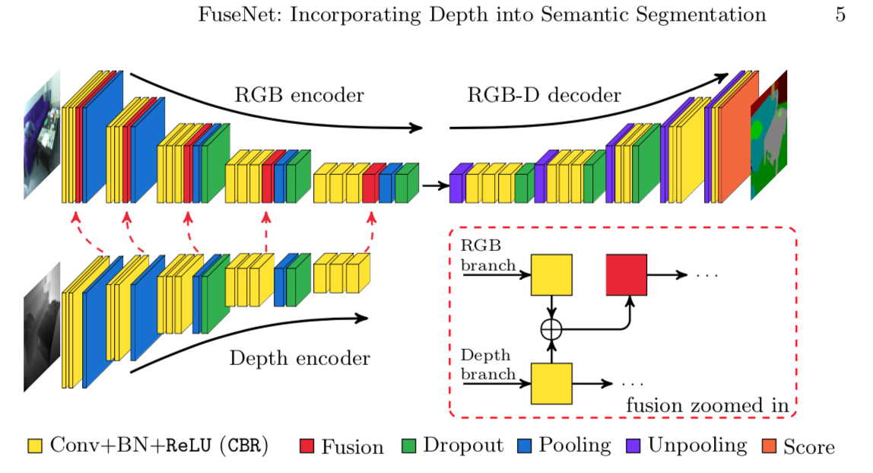

Slide 12
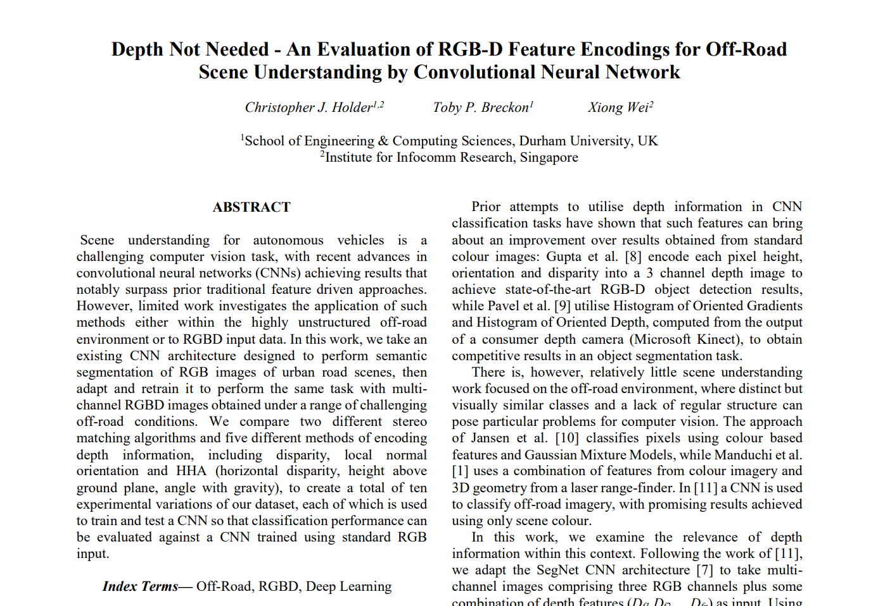
Is depth needed?

Slide 13
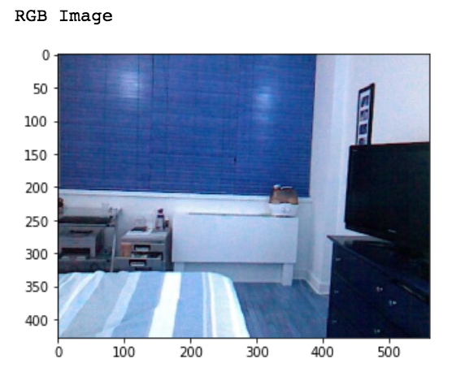
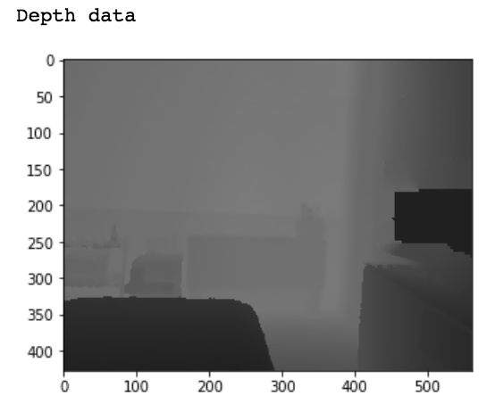
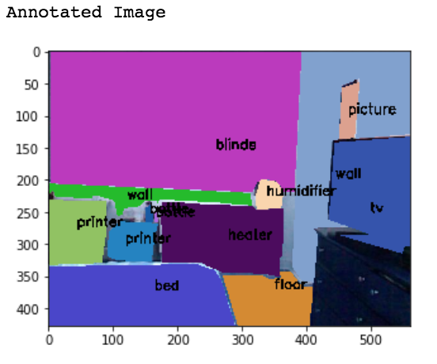
SUN RGB-D dataset and NYU dataset
Annotation format:
{"frames":[{"polygon":
[{"x":[368,368,428,425,427,421,417,466,464],
"y":[2,1,42,84,85,129,136,142,15],
"object":32}]}],
"objects":[{"name": "floor"}]}

Slide 14
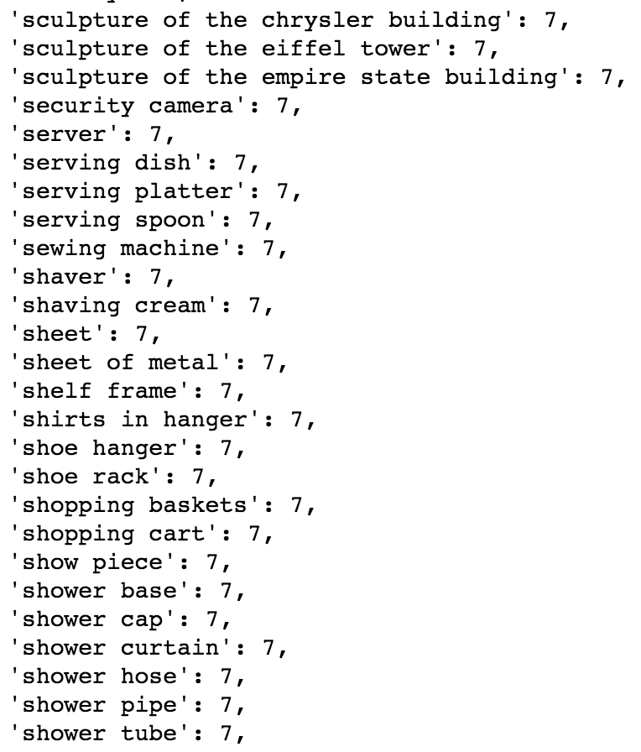
Mapping of classes
label | class
bed | 1
books | 2
ceiling | 3
chair | 4
floor | 5
furniture | 6
objects | 7
picture | 8
sofa | 9
table | 10
tv | 11
wall | 12
window | 13

Slide 15
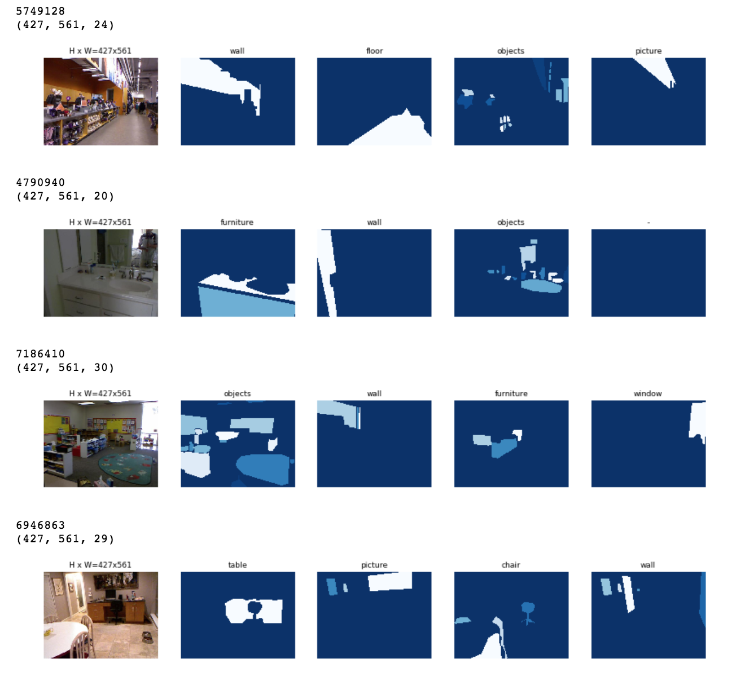

Slide 16
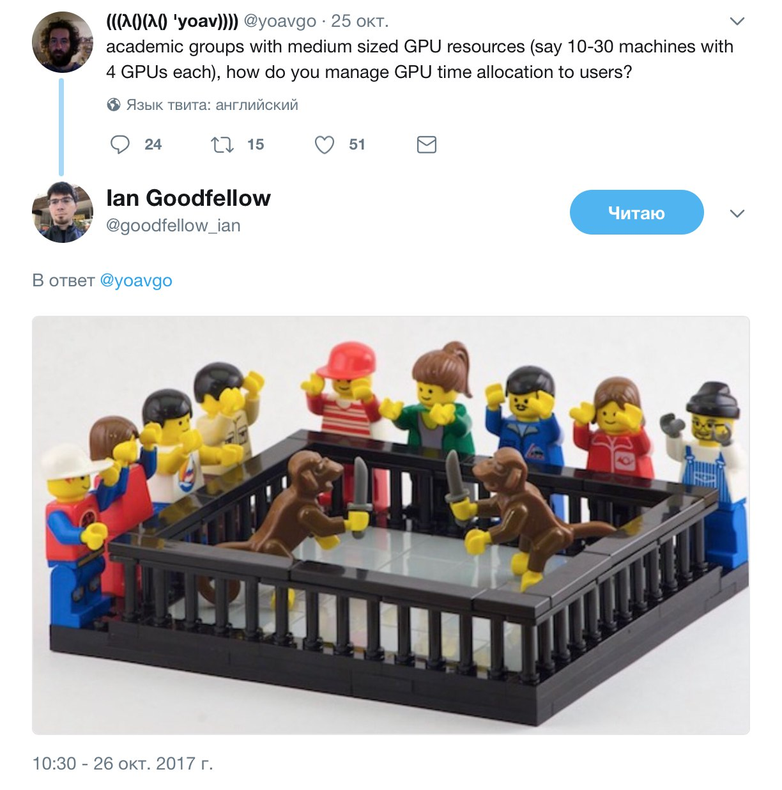
Memory allocation

Slide 17
Pre-processing of the data and model
SUN RGB-D dataset: 10 335 images in total
5 050 - test images
5 285 – train images
1 056 – validation images
NYU dataset: 1449 images in total
1 160 – test images
145 – test images
144 – validation images
All pictures were resized to 1024x1024 and a square shape
Used Mask RCNN v2: Faster R-CNN with ResNet-101 and FPN
Mini-masks were removed
Mini-batch of 1
1 GPU for training/testing
Learning rate from 0.01 to 0.001

Slide 18
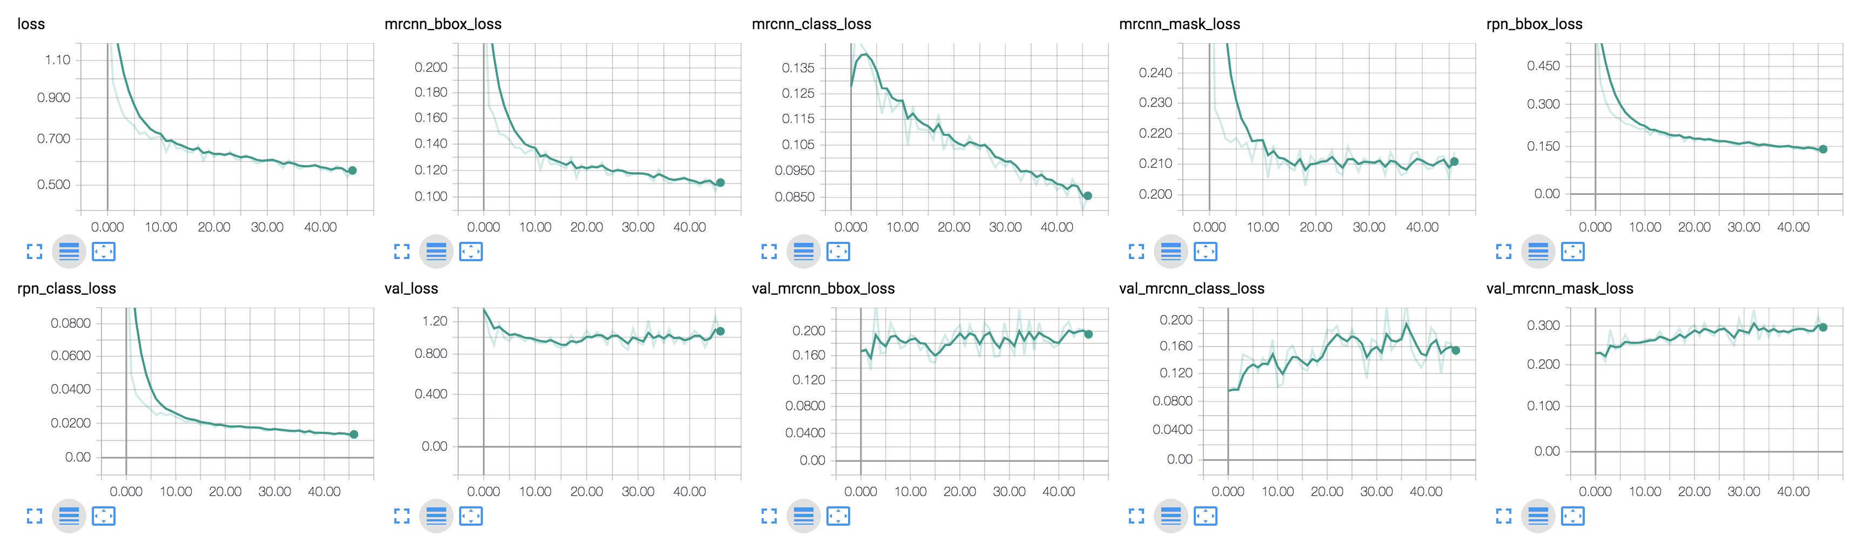
Training heads or all model?
1) The network has reached its smallest error rate and the loss function on validation data does not change anymore. In this case the network has converged.
2) The training loss is getting smaller than validation loss. This indicates that the model is overfitting and further training decreases model’s performance on unseen data.

Slide 19
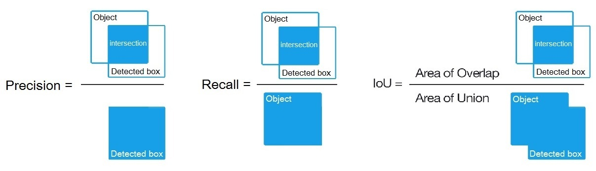
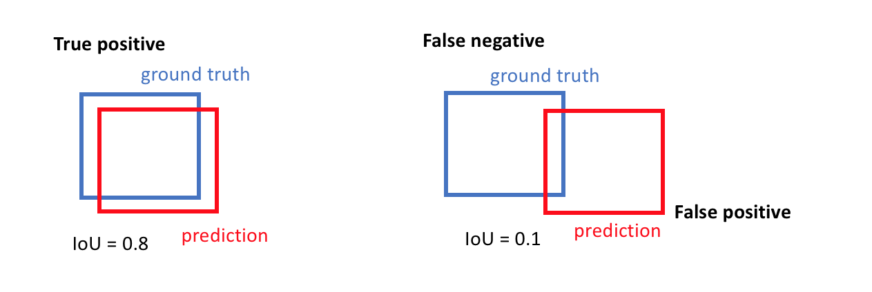
Assessment

Slide 20
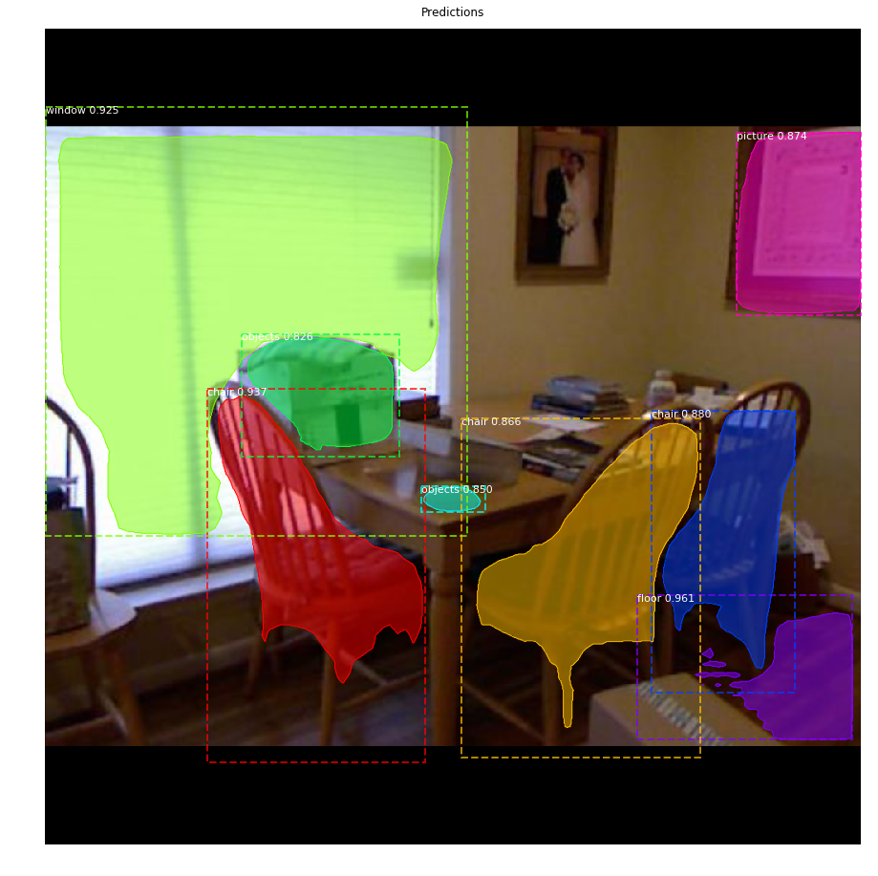
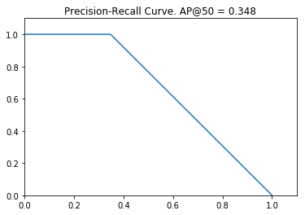
Example result

Slide 21
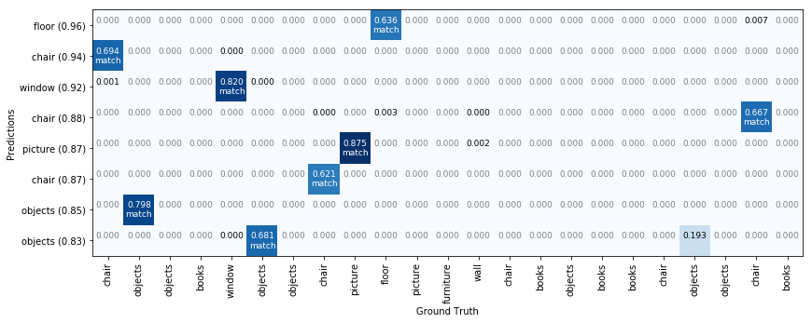
Assessment result
AP (average precious) = 0.347
with IoU 50%

Slide 22
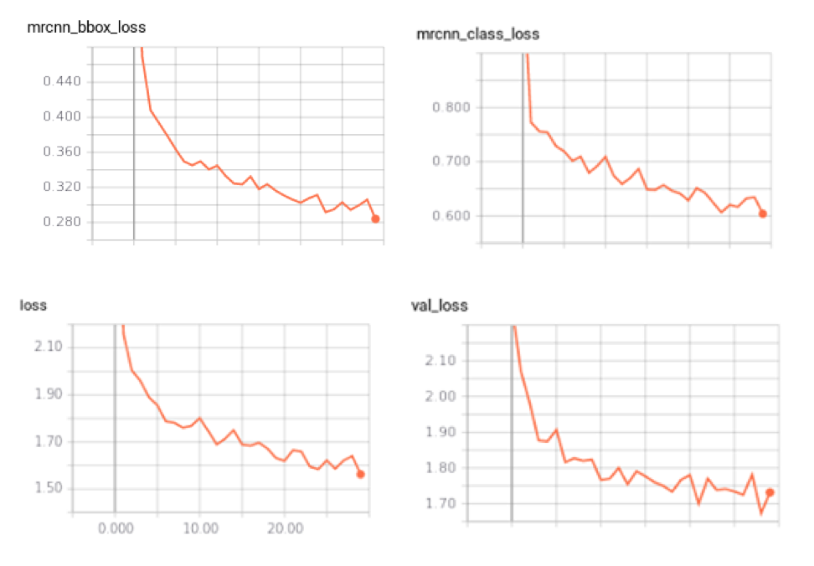
NYU dataset – 0.1 mAP
30 epochs
ResNet 101 and FPN
Pretrained COCO dataset model
Mini-batch size of 1
1 image per GPU
Learning rate from 0.01 to 0.001
SGD plus momentum of 0.9
Weight decay of 0.0001
Default augmentation (flip l/r)

Slide 23
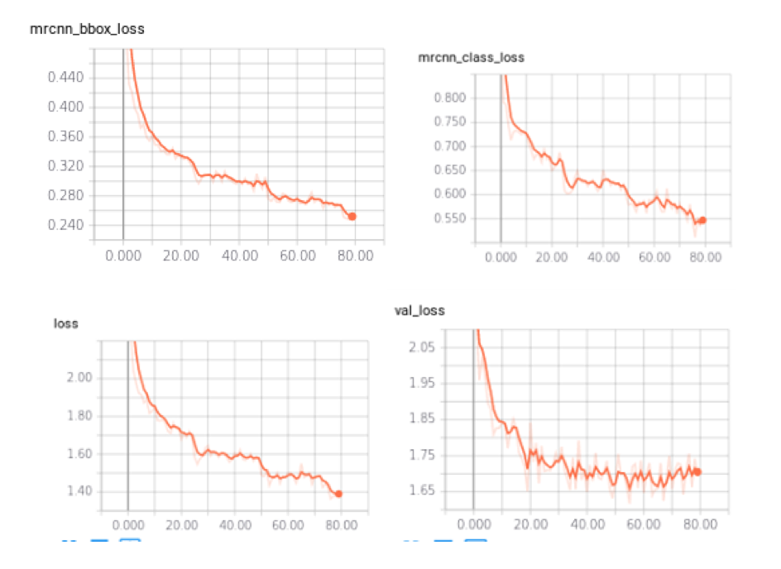
SUN RGB-D dataset – 0.18 mAP
80 epochs
ResNet 101 and FPN
Pretrained COCO dataset model
Mini-batch size of 1
1 image per GPU
Learning rate from 0.01 to 0.001
SGD plus momentum of 0.9
Weight decay of 0.0001
Default augmentation (flip l/r)

Slide 24
There is always a room for improvement
Lighter backbone (e.g., ResNet-50)
ROI mini batch size tuning
BN or dropout probably won’t help
Getting rid of ”object” class, better mapping
Stronger weight decay (i.e., L2 regularization)
Adapting size of the image
Data augmentation
Adam optimiser
Implementing depth channel
Training on 37 classes rather than 13

Slide 25
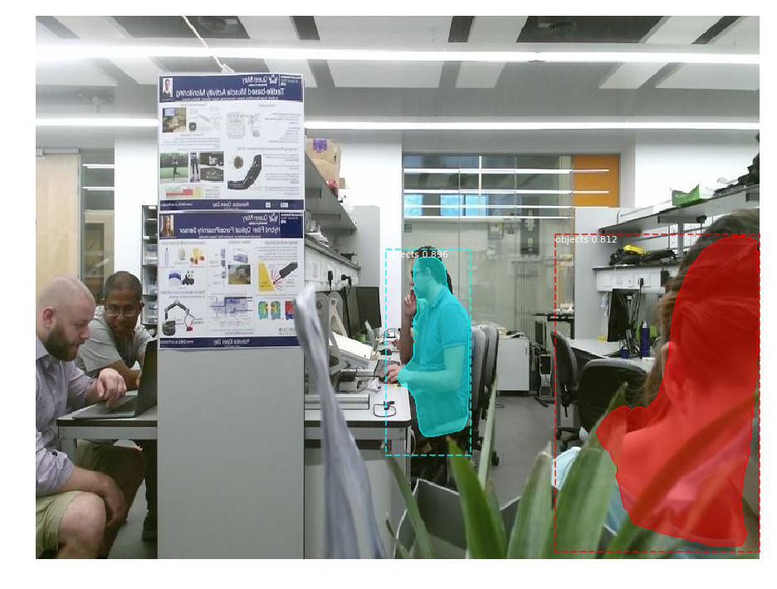
Analysing data from Kinect

Slide 26
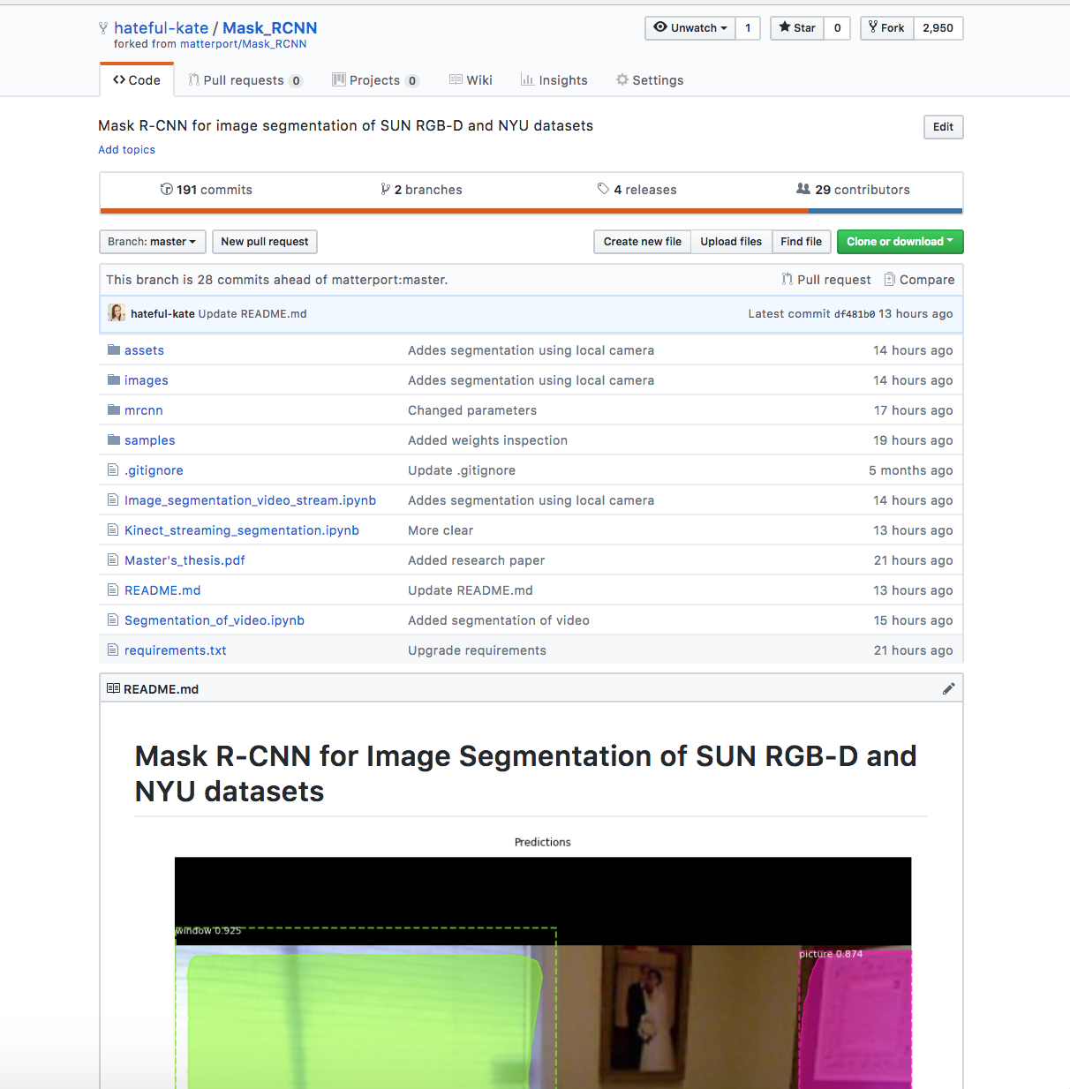
Open source

Slide 27
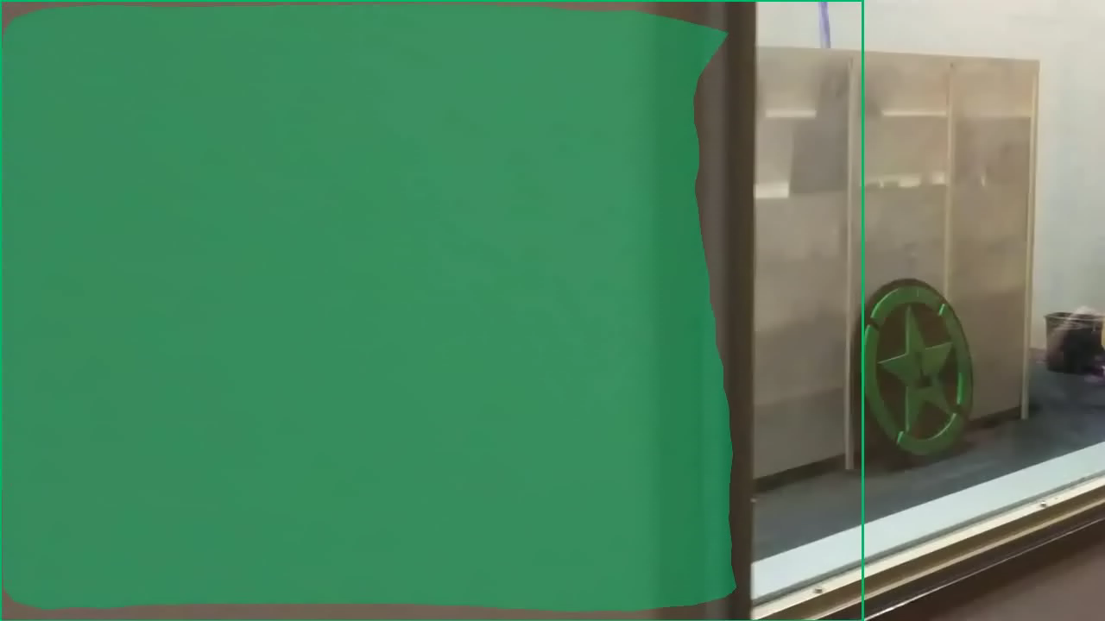

Slide 28
Q&A

Slide 29
Literature
Girshick, Ross B. “Fast R-CNN.” 2015 IEEE International Conference on Computer Vision (ICCV) (2015): 1440-1448.
S. Ren, K. He, R. Girshick and J. Sun, "Faster R-CNN: Towards Real-Time Object Detection with Region Proposal Networks," in IEEE Transactions on Pattern Analysis & Machine Intelligence, vol. 39, no. 6, pp. 1137-1149, 2017.
Shelhamer, Evan et al. “Fully Convolutional Networks for Semantic Segmentation.” IEEE Transactions on Pattern Analysis and Machine Intelligence 39 (2015): 640-651.
Hazırbaş, Caner & Ma, Lingni & Domokos, Csaba & Cremers, Daniel. (2016). FuseNet: Incorporating Depth into Semantic Segmentation via Fusion-Based CNN Architecture. 10.1007/978-3-319-54181-5_14.
Gupta, S., Girshick, R., Arbelaez, P., Malik, J.: Learning rich features from RGB- D images for object detection and segmentation.
D., Pajdla, T., Schiele, B., Tuytelaars, T., eds.: Proceedings of European Conference on Computer Vision. Volume 8695 of Lecture Notes in Computer Science., Zurich, Switzerland, Springer (2014) 345–360
Holder, Christopher J. et al. “Depth Not Needed - An Evaluation of RGB-D Feature Encodings for Off-Road Scene Understanding by Convolutional Neural Network.” CoRR abs/1801.01235 (2017)
.

